Slide 1
MARINE CORPS ENLISTED RANK STRUCTURE

Slide 2
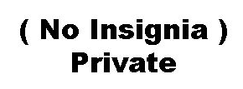
E-1 PRIVATE
WEARS NOTHING

Slide 3
E-2 PRIVATE FIRST CLASS
1 STRIPE UP

Slide 4
E-3 LANCE CORPORAL
1 STRIPE UP
CROSSED RIFLES

Slide 5
E-4 CORPORAL
2 STRIPES UP
CROSSED RIFLES

Slide 6
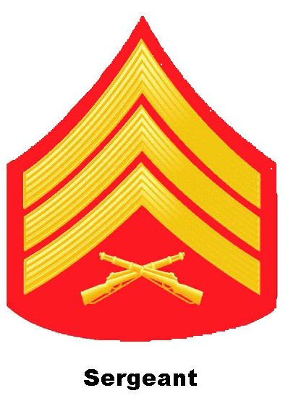
E-5 SERGEANT
3 STRIPES UP
CROSSED RIFLES

Slide 7
E-6 STAFF SERGEANT
3 STRIPES UP 1 STRIPE DOWN
CROSSED RIFLES

Slide 8
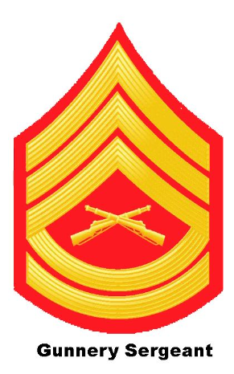
E-7 GUNNERY SERGEANT
3 STRIPES UP 2 STRIPES DOWN
CROSSED RIFLES

Slide 9
E-8 MASTER SERGEANT
3 STRIPES UP 3 STRIPES DOWN
CROSSED RIFLES

Slide 10
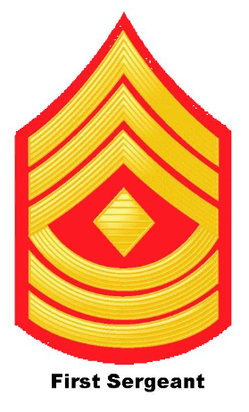
E-8 1ST SERGEANT
3 STRIPES UP 3 STRIPES DOWN
DIAMOND IN THE CENTER

Slide 11
E-9 MASTER GUNNERY SERGEANT
3 STRIPES UP 4 STRIPES DOWN
BURSTING BOMB IN THE CENTER

Slide 12
E-9 SERGEANT MAJOR IN THE MARINE CORPS
3 STRIPES UP 4 STRIPES DOWN
STAR IN THE CENTER

Slide 13
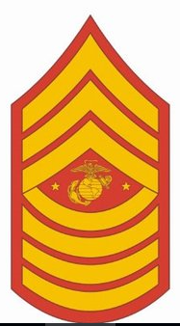
E-9 SERGEANT MAJOR OF THE MARINE CORPS
3 STRIPES UP 4 STRIPES DOWN
EAGLE GLOBE & ANCHOR FLANKED BY 2 STARS

Slide 14
NAVY ENLISTED RANK STRUCTURE

Slide 15
E-1 SEAMAN RECRUIT
WEARS NOTHING

Slide 16
E-2 SEAMAN APPRENTICE
2 DIAGONAL STRIPES

Slide 17
E-3 SEAMAN
3 DIAGONAL STRIPES

Slide 18
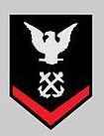
E-4 PETTY OFFICER 3RD CLASS
EAGLE PERCHED OVER 1 CHEVRON

Slide 19
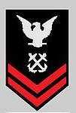
E-5 PETTY OFFICER 2ND CLASS
EAGLE PERCHED OVER 2 CHEVRONS

Slide 20
E-6 PETTY OFFICER 1ST CLASS
EAGLE PERCHED OVER 3 CHEVRONS

Slide 21
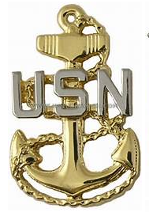
E-7 CHIEF PETTY OFFICER
FOULED ANCHOR FLANKED BY USN

Slide 22
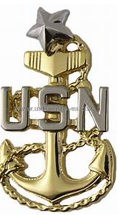
E-8 SENIOR CHIEF PETTY OFFICER
FOULED ANCHOR FLANKED BY USN WITH 1 STAR

Slide 23
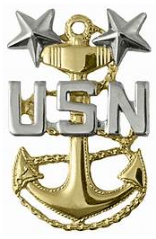
E-9 MASTER CHIEF PETTY OFFICER IN THE NAVY
FOULED ANCHOR FLANKED BY USN WITH 2 STARS

Slide 24
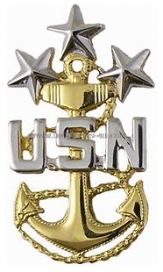
E-9 MASTER CHIEF PETTY OFFICER OF THE NAVY
FOULED ANCHOR FLANKED BY USN WITH 3 STARS

